Slide 1
SQL
What?
# Stands For Structured Query Language.

Slide 2
Naming Reason
The original full name of SQL was SEQUEL, which stood for "Structured English Query Language". A language which has been structured in English or lets say English-Like Query language which follows the syntax structure of English.
Query: ask, Examination, question
Example -
SELECT PRICE FROM BOOKS WHERE NAME = ‘DATABASE SYSTEM CONCEPT’

Slide 3
Who?
Standard of the American National Standards Institute (ANSI) in 1986, and of the International Organization for Standardization (ISO) in 1987.

Slide 4
Why?
Using this access and manipulate databases.
TO DO:
SQL can
Execute queries against a database
Retrieve data from a database
Insert records in a database
Update records in a database
Delete records from a database
Create new databases
Create new tables in a database
Create views in a database
Set permissions on tables, procedures, and views

Slide 5
DBMS & RDBMS
DBMS | RDBMS
DBMS applications store data as file. | RDBMS applications store data in a tabular form.
DBMS uses file system to store data, so there will be no relation between the tables. | RDBMS, data values are stored in the form of tables, so a relationship between these data values will be stored in the form of a table as well.
DBMS is meant to be for small organization and deal with small data. it supports single user. | RDBMS is designed to handle large amount of data. it supports multiple users.
Examples of DBMS are file systems, xml etc. | Example of RDBMS are mysql, postgre, sql server, oracle etc.

Slide 6
RDBMS
RDBMS stands for Relational Database Management System.
MS SQL Server, IBM DB2, Oracle, MySQL, and Microsoft Access.
The data in RDBMS is stored in database objects called tables.
A table is a collection of related data entries and it consists of columns and rows.

Slide 7
Categories
DDL – Data Definition Language
DQL – Data Query Language
DML – Data Manipulation Language
DCL – Data Control Language

Slide 8
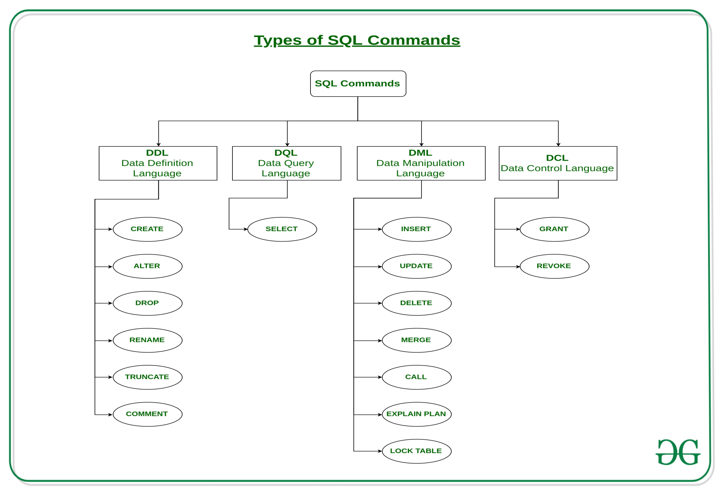

Slide 9
DDL
DDL or Data Definition Language actually
That can be used to define the database schema.
Used to create and modify the structure of database objects in the database.
Create- used to create the database
Drop- used to delete objects from the database.
Alter- used to alter the structure of the database.
Truncate-used to remove all records from a table, including all spaces allocated for the records are removed.
Comment-is used to add comments to the data dictionary.
Rename-is used to rename an object existing in the database.

Slide 10
DQL
DQL statements are used for performing queries on the data within schema objects.
The purpose of the DQL Command is to get some schema relation based on the query passed to it.
Select- is used to retrieve data from the database.

Slide 11
DML
Data Manipulation Language.
That deals with the manipulation of data present in the database
Insert -to insert data into a table.
Update-to update existing data within a table.
Delete-to delete records from a database table.

Slide 12
DCL
Data Control Language.
DCL includes commands such as GRANT and REVOKE which mainly deal with the rights, permissions and other controls of the database system.
GRANT-gives user’s access privileges to the database.
  REVOKE-withdraw user’s access privileges given by using the GRANT command.

Slide 13
TCL
Transaction Control Language
TCL commands deal with the transaction within the database.
Commit – commits a Transaction.
Rollback – rollbacks a transaction in case of any error occurs.
Save point –sets a save point within a transaction.
Set Transaction – specify characteristics for the transaction.

